Slide 1


Asymptotic notations based on order of growth; Asymptotic Notations numerical Session No.: 3 Course Name: Design and analysis of algorithms Course Code: R1UC302B Instructor Name: Mr. Pradeep Chauhan Duration: 45 min Date of Conduction of Class: 07/03/2025

Slide 2
RECAP: Asymptotic running time of an algorithm An approximation of the number of computational steps performed by an algorithm by a “simple” function of similar order of growth. ・it is always expressed as a function of the input size • asymptotic upper bound — big-Oh O( ) • asymptotic lower bound — big-Omega Ω( ) • asymptotic (tight) bound — big-Theta Θ( )

Slide 3
At the end of this session students will be able to
Learning Outcome 1:Analyse various asymptotic notations.
Learning Outcome 2 : Analyse order of growth of various functions.

Slide 4
Session Outline
1 Introduction
2 Asymptotic Notations Analysis
3
Learning Activity-1(Think-Pair)
4
Comparison of Running time
5
Learning Activity – 2(Individual)
6
Summary and Reflection

Slide 5
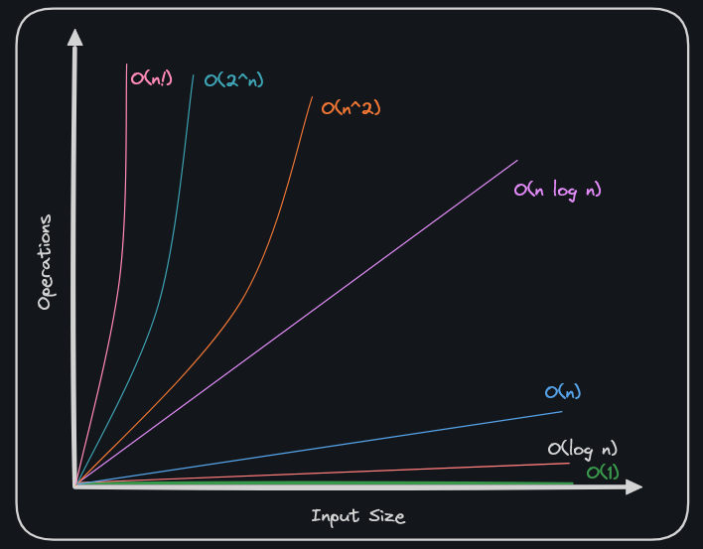

Slide 6
Introduction to order of growth
An order of growth is a set of functions whose asymptotic growth behavior is considered equivalent. For example, 2n, 100n and n+1 belong to the same order of growth, which is written O(n) in Big-Oh notation and often called linear because every function in the set grows linearly with n.
All functions with the leading term n² belong to O(n²); they are quadratic, which is a fancy word for functions with the leading term n².
The following table shows some of the orders of growth that appear most commonly in algorithmic analysis, in increasing order of badness.

Slide 7
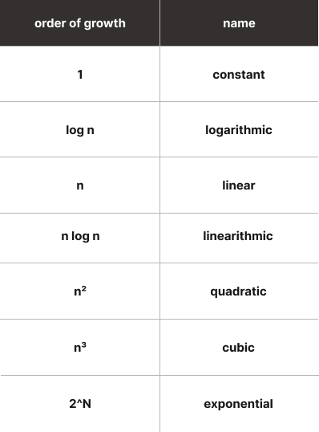

Slide 8
Comparison of Running time
For larger n, the growth of time complexity is
c < Log n < √n < n < n log n < n² < n³ < 2^{n} < 3^{n} < n! < n^{n}

Slide 9
Learning Activity – 1(10 min) (Think Pair Share)
Explain with example why we need only Big O notation in some cases.
Explain with example where we can not use Big O notation.
Time complexity of an algorithm can be calculated by

Slide 10
Activity-2(10 min) MCQ Quiz

Slide 11
Summary
We introduced orders of growth and saw which of them are desirable for solving problems.
Then, we introduced case analysis for algorithms and saw how they are connected to asymptotic notations.

Slide 12
Discussion on the post session activities
Ask your doubts

Slide 13
Information about the next lesson
Analysis Framework and Empirical Analysis

Slide 14
Review and Reflection from students
Provide your feedback on the Session-3.

